Slide 1
Artistic Pressure
By: Sewit Eskinder, Ashwin Udupa,
Jason Burke, and Audrey Fermanich
Group 9

Slide 2
Introduction
Purpose: Analyze recent trending artists and songs
Dataset chosen: Spotify Top 200
Artists selected: Doja Cat (Sewit), Drake (Ashwin), Ed Sheeran (Jason), The Weeknd (Audrey)
Notes:
Audrey

Slide 3
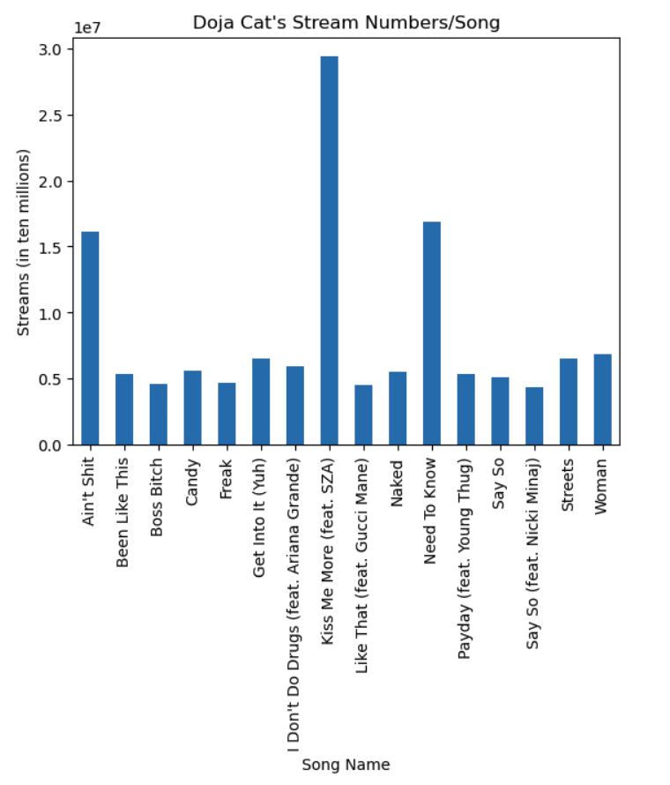
Doja Cat
Followers: 8,671,649
Songs in the Top 200: 16
Doja Cat does not have a #1
Total Number of Streams: 133,496,415
Notes:
Doja Cat has made it onto the top 200 spotify charts 185 times, with 16 different songs, totalling over 133 million streams. During 202-2021, she had 8.6 million followers, and her most listened song was Kiss Me More ft. SZA which had over 29 million streams

Slide 4
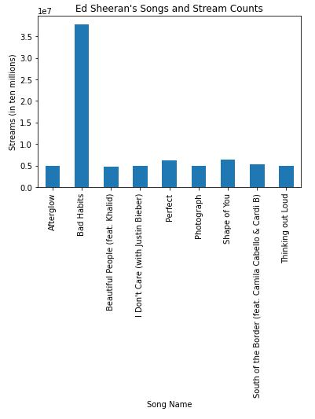
Ed Sheeran
Number of Followers: 83,337,783
Number of Songs in Top 200: 9
Ed Sheeran did not have a #1
Total Number of Streams: 80,580,568
Notes:
Ed Sheeran
At the time of this dataset, Ed Sheeran had only 83 million followers, as of today on spotify, he is the number 1 most followed artist with over 109 million followers and the number 4 most streamed artist on spotify.

Slide 5
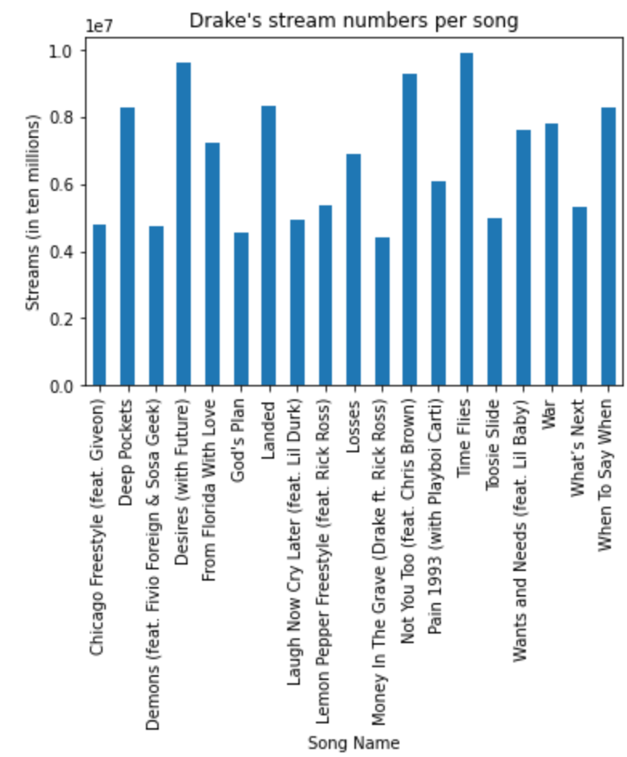
Drake
Followers: 56,327,031
Songs in the Top 200: 19
#1’s on the charts: 0
Total Number of Streams: 128,538,281
Notes:
4th most followed artist on Spotify as of today and the most streamed artist
Time Flies - Most streamed song during that time with 9.9 million streams

Slide 6
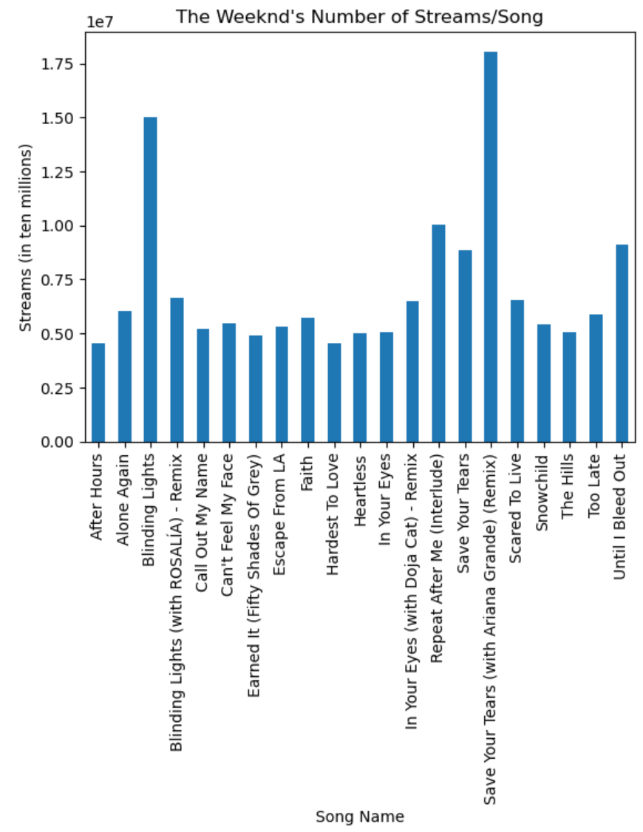
The Weeknd
Number of Followers: 35,340,069
Songs in Top 200: 21
#1 Song: Blinding Lights
Total Number of Streams: 149,088,439
Notes:
The week of highest charted #1 hit was 6/12/2020. “Blinding Lights” spent 90 weeks on the Billboard top 100.

Slide 7
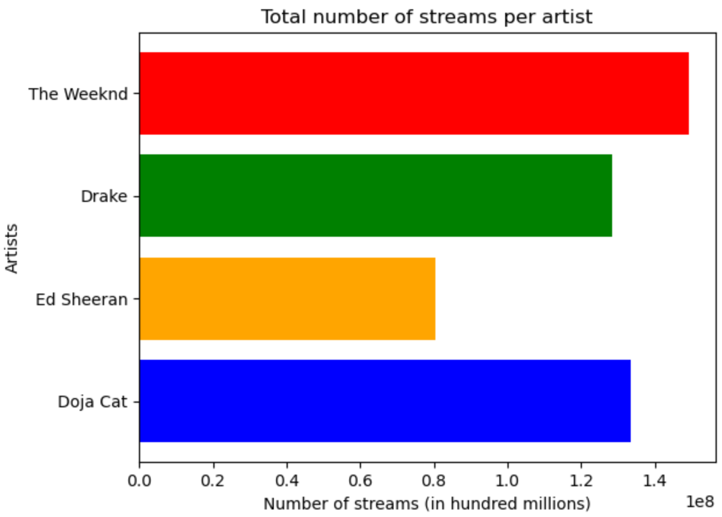
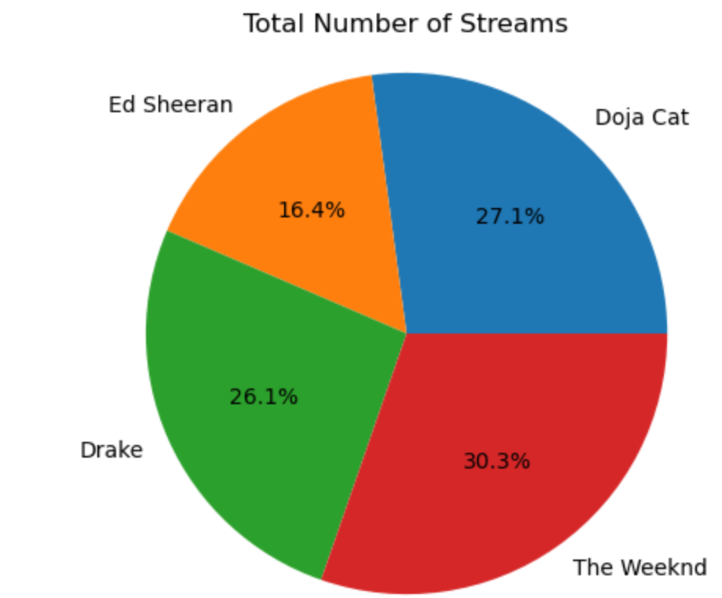
Total Number of Streams
Notes:
Sewit
The Weeknd has the most number of streams per artist at 149,088,439 streams while Ed Sheeran has the least with 80,580,568 streams
the way the dataframe read in the streams columns, it had commas so it read the numbers as strings and not integers, so we had to convert the column into integers before aggregating the number of streams each artist had

Slide 8
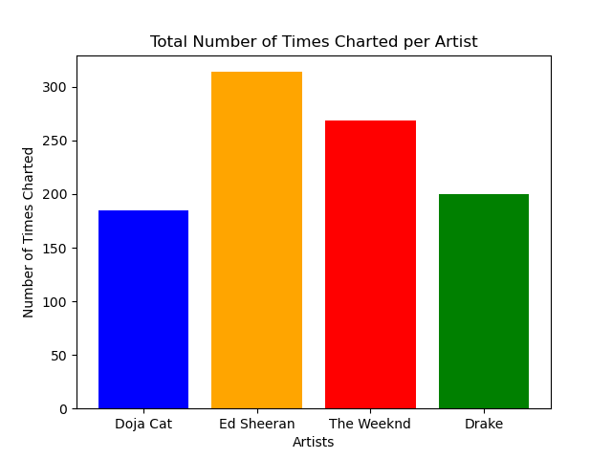
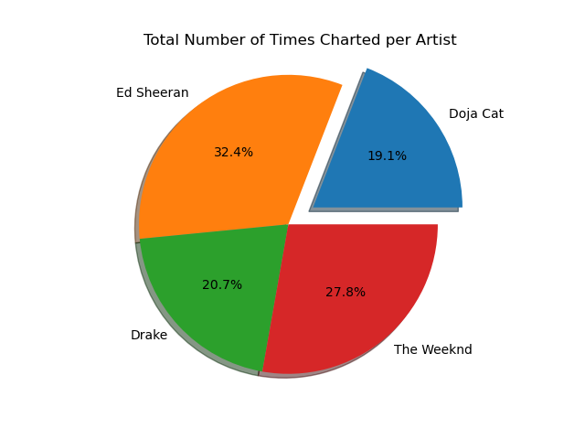
Total Number of Times Charted per Artist
Notes:
Jason
As we can see, Ed Sheeran leads with the total number of times charted being over 300, and Doja Cat with the least and just under 200 times on the charts. Of the four artists, ed sheeran is leading with over 32% and we displayed the raw numbers in the bar graph

Slide 9
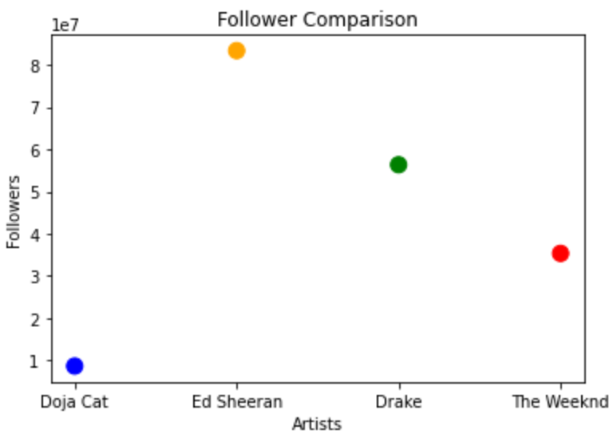
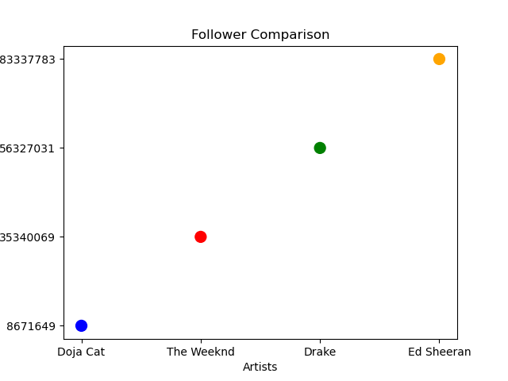
Follower Comparison
Notes:
Ashwin
As shown in this scatter plot, Ed Sheeran has the most amount of followers at over 80 million and Doja Cat has the least amount of followers falling just under 10 million.

Slide 11
Conclusion
Compared different data points among artists to evaluate popularity
Data implications for future music trends
Data limitations
Notes:
Audrey( BP 1 and slide 10)
Sewit (data limitation) The data provided information regarding the highest charting position for each song as well as the number of times each song has charted, however we were unable to view how long each song maintained its highest charting position.
Jason (implications for future music trends)

Slide 12

Questions

Slide 13
Resources
https://www.kaggle.com/datasets/sashankpillai/spotify-top-200-charts-20202021

